Slide 1
Chapter 8
  Information Security

Slide 2
Learning Objectives (1 of 2)
身份验证
Explain the difference between authentication and authorization
Explain the use of a hash function to encrypt passwords on a computer system
Describe cyber-attacks including viruses, worms, Trojan horses, DoS attacks, and phishing, and explain how they differ from each other
Describe ways to increase the security of information on your computer and online
Encrypt and decrypt messages using simple Caesar ciphers and matrix-based block ciphers
授权
加密
网络攻击
密码
Notes:
解释身份验证和授权之间的区别
解释使用哈希函数对计算机系统上的密码进行加密
描述网络攻击，包括病毒，蠕虫，特洛伊木马，DoS攻击和网络钓鱼，并说明它们之间的区别
描述提高计算机和在线信息安全性的方法
使用简单的Caesar密码和基于矩阵的分组密码对消息进行加密和解密

Slide 3
Learning Objectives (2 of 2)
对称加密算法
Describe the overall process used by symmetric encryption algorithms such as DES
Describe the overall process used by RSA public-key encryption
Explain why web transmission protocols such as SSL and TLS use multiple forms of encryption to secure data transfer over the web
Explain the importance of computer security for networked embedded systems
Notes:
描述对称加密算法（例如DES）使用的总体过程
描述RSA公钥加密使用的总体过程
说明为什么网络传输协议（例如SSL和TLS）使用多种形式的加密来确保通过网络的数据传输的安全
解释计算机安全对网络嵌入式系统的重要性

Slide 4
Introduction
Information security
  Keep information safe
  Control access to authorized people only
Physical security
  lock doors
  maintain control of devices
Online security
  Secure assembly language
  Secure operating system
  Secure network
仅控制对授权人员的访问
人身安全
锁门
保持对设备的控制
在线安全
安全的汇编语言
安全操作系统
安全网络
Notes:
信息安全
确保信息安全
仅控制对授权人员的访问
人身安全
锁门
保持对设备的控制
在线安全
安全的汇编语言
安全操作系统
安全网络

Slide 5
Threats and Defenses
Threats online are often more dangerous than threats to physical items
Hackers prefer to attack easily accessible data
Multiple deterrents to online attacks
Notes:
在线威胁通常比对实物威胁更为危险
黑客更喜欢攻击易于访问的数据
多种威慑网上攻击

Slide 6
Threats and Defenses Authentication and Authorization (1 of 8)
身份验证
Authentication: establishing identity
Require usernames and passwords
Secure a password file with a hash function;
one-way encryption
Example: password = badboy2
  Replace letters by numbers: 2 1 4 2 15 25 2
  Add digits: 2 + 1 + 4 + 2 + 15 + 25 + 2 = 51
  Remainder of sum/7: 51 mod 7 = 2
  Add 1 and multiply by 9: (2 + 1) × 9 = 27
  Reverse digits and convert to letters: 72 = gb
Notes:
身份验证：建立身份
需要用户名和密码
使用哈希功能保护密码文件； 单向加密
示例：密码= badboy2
用数字代替字母：2 1 4 2 15 25 2
加数位：2 +1 + 4 + 2 + 15 + 25 + 2 = 51
sum / 7的余数：51 mod 7 = 2
加1并乘以9：（2 +1）×9 = 27
反转数字并转换为字母：72 = gb

Slide 7
Threats and Defenses Authentication and Authorization (2 of 8)
Password file security: no plaintext password stored
On login
  Read username and password
  Look up entry for username in a password file
  Hash input password and compare
More secure method
  Keep password creation time
  Add creation time to password before hashing
  Identical passwords won’t hash to identical values
Notes:
密码文件安全性：不存储纯文本密码
登录时
读取用户名和密码
在密码文件中查找用户名条目
哈希输入密码并进行比较
更安全的方法
保持密码创建时间
在哈希之前将创建时间添加到密码
相同的密码不会散列为相同的值

Slide 8
Threats and Defenses Authentication and Authorization (3 of 8)
Password attacks
Guess password, brute force or from knowledge
  Try common passwords (e.g,123456)
  Try personal references (e.g., pet name)
  Try all possible passwords (computationally difficult)
Steal password file and use password-cracking software
  Tries words and word combinations, millions of password possibilities per second
Social engineering: get a person to tell password
Notes:
密码攻击
猜测密码，蛮力或从知识
尝试使用通用密码（例如123456）
尝试使用个人推荐（例如，宠物的名字）
尝试所有可能的密码（计算困难）
窃取密码文件并使用密码破解软件
尝试单词和单词组合，每秒数百万种密码的可能性
社会工程：请人告诉密码

Slide 9
Threats and Defenses Authentication and Authorization (4 of 8)
Other authentication methods
Answer personal information question
Biometric information (fingerprint or retinal scans)
One-time password scheme
  User enters ID and a partial password
  System or user device generates last half of the password
  Last half of the password is good for only a few seconds
Dual authentication: Temporary code or password is sent to a trusted device
Notes:
其他认证方式
回答个人信息问题
生物特征信息（指纹或视网膜扫描）
一次性密码方案
用户输入ID和部分密码
系统或用户设备生成密码的后半部分
密码的后半段仅持续几秒钟
双重身份验证：临时代码或密码发送到受信任的设备

Slide 10
Threats and Defenses Authentication and Authorization (5 of 8)
Authorization: set of permitted actions for each authorized person
Operating system maintains access control lists
  Read access (read a file)
  Write access (modify a file)
  Execute access (run a program)
  Delete access (remove a file)
System administrator or superuser has universal access and sets up authorization
Notes:
授权：为每个授权人设置的一组允许的操作
操作系统维护访问控制列表
读取访问权限（读取文件）
写访问权限（修改文件）
执行访问（运行程序）
删除访问权限（删除文件）
系统管理员或超级用户具有通用访问权限并设置了授权

Slide 11
Threats and Defenses Authentication and Authorization (6 of 8)
Malware: malicious software arriving from the network
  Virus: program embedded within another program or file, replicates itself and attacks other files
  Worm: program that can send copies of itself to other nodes on the network
  Trojan horse: program that seems beneficial but hides malicious code within it
    Keystroke logger: records all keys typed
    Drive-by exploit/drive-by download: Trojan horse downloaded by simply visiting an infected website
恶意软件：来自网络的恶意软件
Notes:
恶意软件：来自网络的恶意软件
病毒：嵌入另一个程序或文件中的程序，自我复制并攻击其他文件
蠕虫：可以将自身副本发送到网络上其他节点的程序
特洛伊木马程序：看似有益但隐藏恶意代码的程序
按键记录器：记录所有键入的按键
偷渡式漏洞利用/偷渡式下载：只需访问受感染的网站即可下载特洛伊木马

Slide 12
Threats and Defenses Authentication and Authorization (7 of 8)
Denial-of-service (DoS) attack: many computers try to access the same URL at the same time
  Clogs the network, prevents legitimate access, and causes the server to crash
  Distributed DoS uses thousands of computers
    Uses a zombie army (botnet): many innocent computers infected with malware
Phishing: obtain sensitive information by impersonating legitimate sources
  Many emails; just a few “bites” are enough
Notes:
拒绝服务（DoS）攻击：许多计算机尝试同时访问同一URL
阻塞网络，阻止合法访问，并导致服务器崩溃
分布式DoS使用数千台计算机
使用僵尸军队（僵尸网络）：许多无辜的计算机感染了恶意软件
网络钓鱼：通过假冒合法来源获取敏感信息
许多电子邮件； 只需“咬一口”就足够了

Slide 13
Threats and Defenses Authentication and Authorization (8 of 8)
White hats are security experts and those who work to help protect systems from attackers.
Black hats are individuals or groups who work toward getting around security to steal information, get money, or do other nefarious, immoral, and illegal acts.
Notes:
白帽是安全专家，也是致力于保护系统免受攻击者攻击的人。
戴黑帽子的人或团体致力于绕过安全设施窃取信息，获取金钱或进行其他邪恶，不道德和非法的行为。

Slide 14
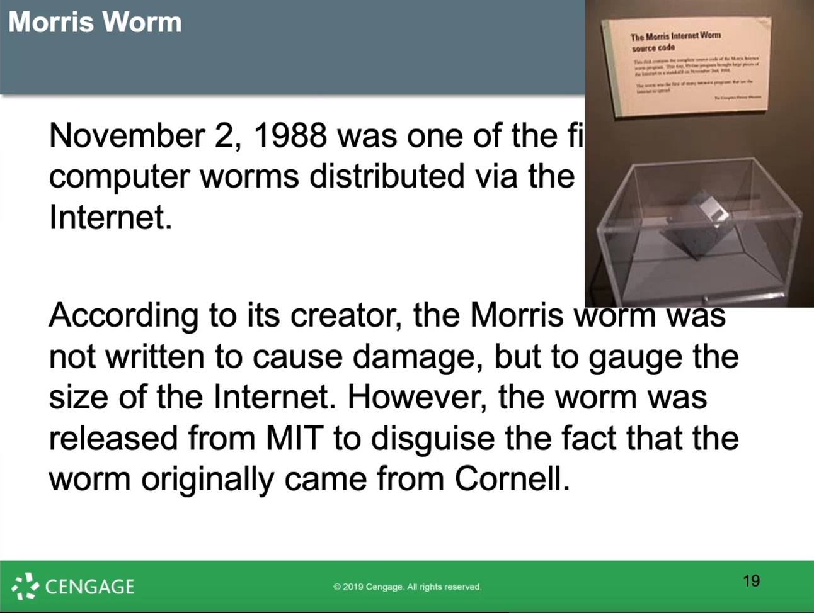
第一个worm

Slide 15
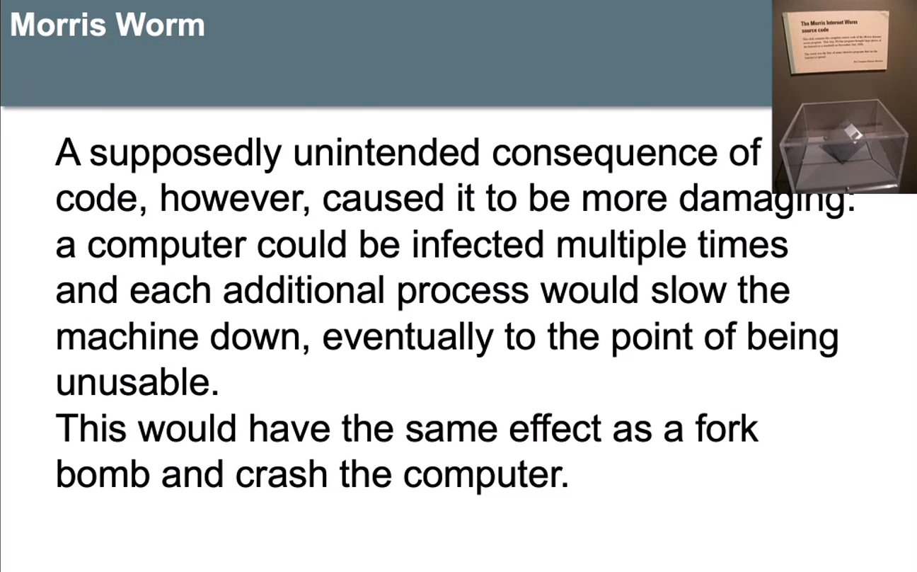

Slide 16
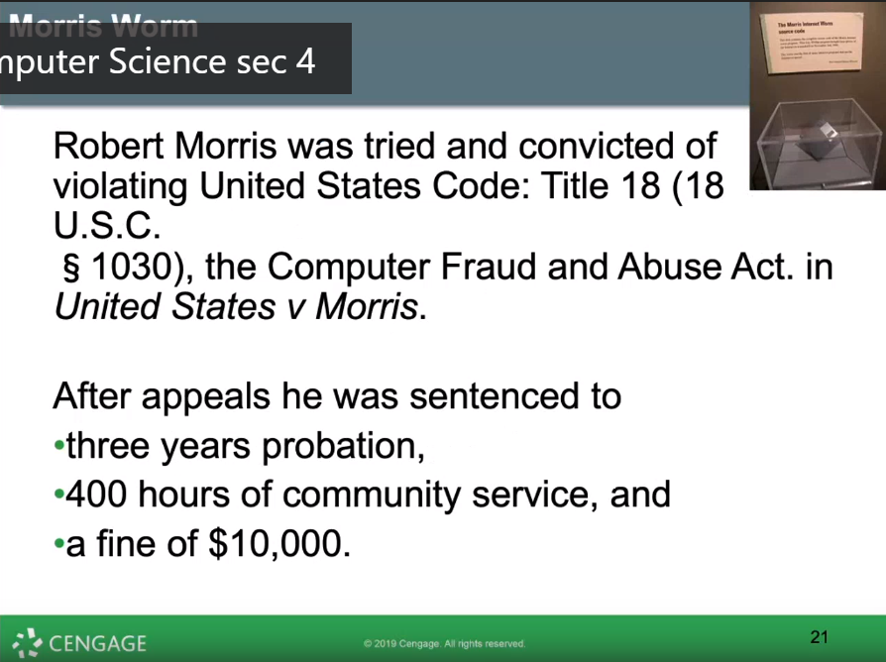

Slide 17
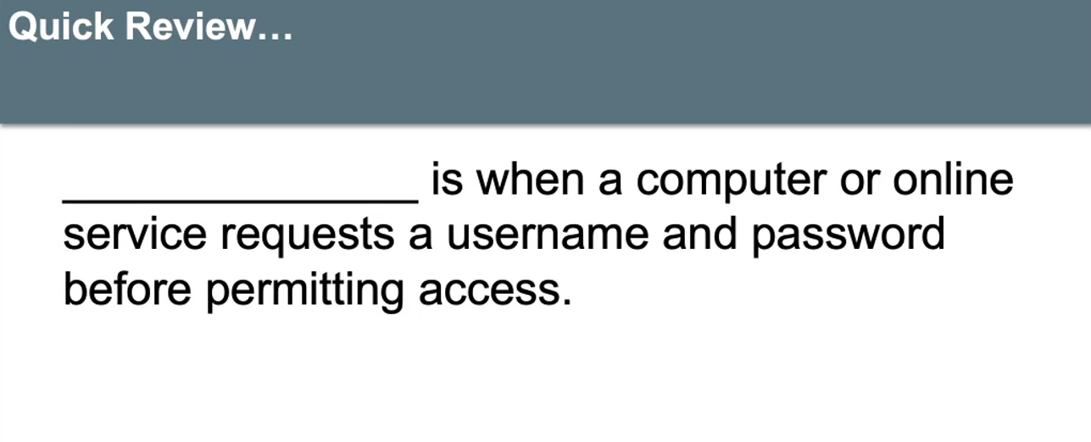
Authentication 身份验证

Slide 18
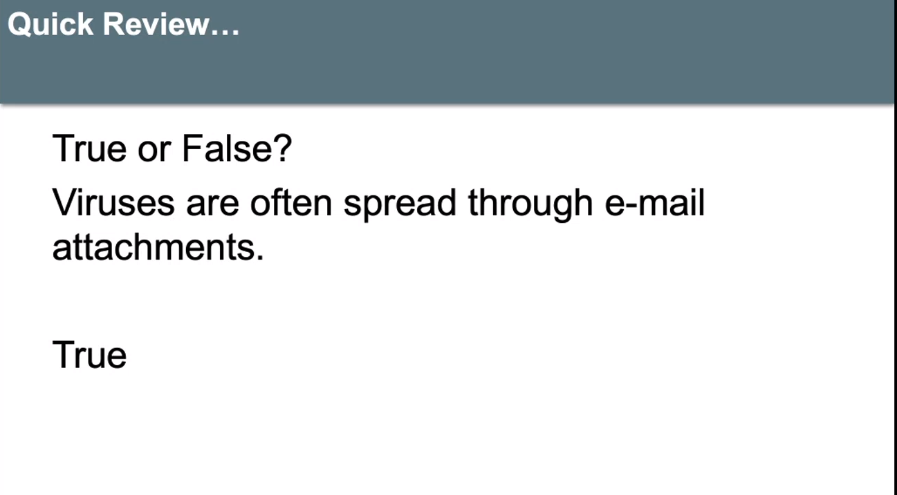

Slide 19
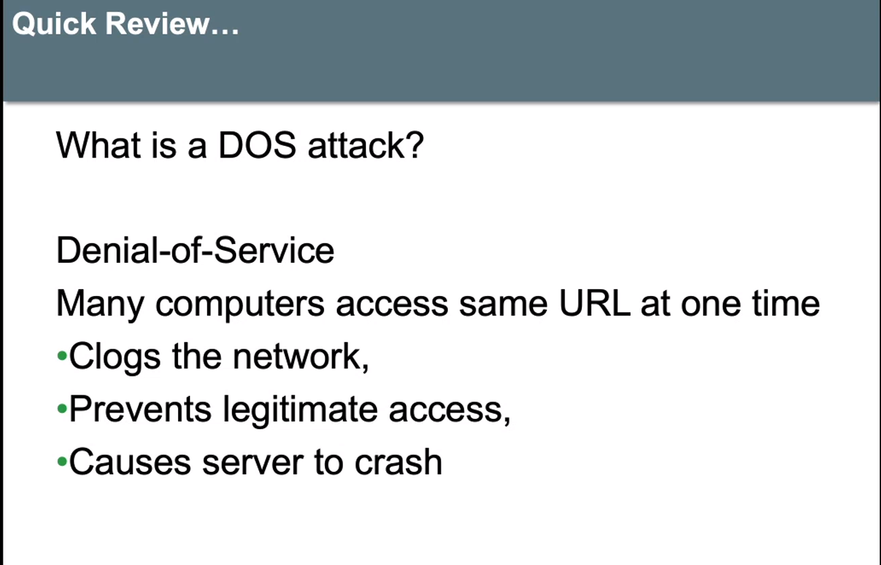

Slide 20
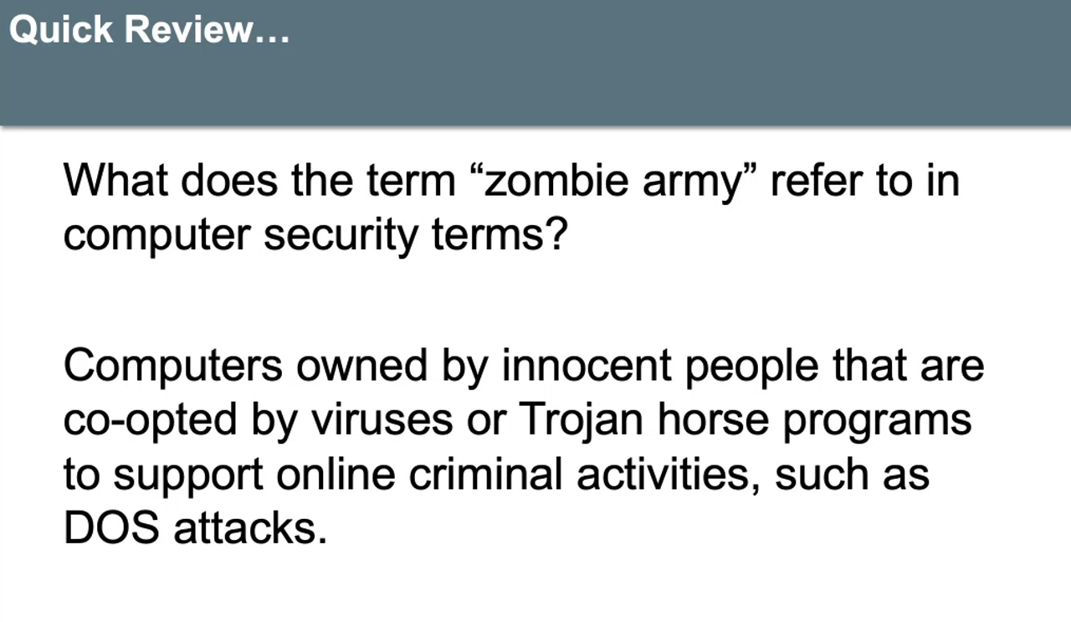
DDoS

Slide 21
Encryption Overview
Cryptography: science of “secret writing”
Encryption and decryption (inverse operations)
  Convert from plaintext to ciphertext and back again
Symmetric encryption algorithm
  A secret key shared by the sender and the receiver
  Same key is used to encrypt and decrypt
Asymmetric encryption algorithm (public key)
  Uses two keys: public and private
  Use public key (generally known) to encrypt
  Use private key (known only to receiver) to decrypt
我们要encrypt加密的东西是plaintext
加密之后就变成ciphertext
Notes:
密码学：“秘密写作”的科学
加密和解密（逆运算）
从纯文本转换为密文，然后再次返回
对称加密算法
发送者和接收者共享的密钥
使用相同的密钥进行加密和解密
非对称加密算法（公钥）
使用两个密钥：公开和私有
使用公钥（通常已知）进行加密
使用私钥（仅接收者知道）解密

Slide 22
Encryption Simple Encryption Algorithms (1 of 5)
Caesar cipher (shift cipher)
  Map characters to others a fixed distance away in the alphabet
  Example: A→E, B→F, C→G…U→Y, V→Z, W→A
  Stream cipher: encode each character as it comes
Substitution cipher: similar, but implement other mappings
Pros: easy and fast, can do character by character
Cons: letter frequency, double letters, still pertain, make it easy to break
One character at the time
不需要按顺序
Notes:
凯撒密码（移位密码）
将字符映射到与字母固定距离的其他人
例如：A→E，B→F，C→G…U→Y，V→Z，W→A
流密码：对每个字符进行编码
替代密码：相似，但实现其他映射
优点：简单快速，可以逐个字符地做
缺点：字母频率，双字母，仍然适用，容易折断

Slide 23
Encryption Simple Encryption Algorithms (2 of 5)
Block cipher
Block of plaintext encoded into a block of ciphertext
Each character contributes to multiple characters
Matrix-based block cipher
  Group characters into blocks n characters long
  Find invertible n by n matrix, M, and its inverse, M′ as keys
  Map characters to letters A→1, B→2, etc.
  Wrap values 26 and above back to zero: 26→0, 27→1, etc.
Symmetric encryption algorithm
Notes:
分组密码
将明文块编码为密文块
每个角色贡献多个角色
基于矩阵的分组密码
将字符分组为n个字符长的块
通过矩阵n求n的可逆n及其倒数M'作为键
将字符映射到字母A→1，B→2等
将值26以上的值换回零：26→0、27→1，依此类推。

Slide 24
Encryption Simple Encryption Algorithms (3 of 5)
FIGURE 8.1
Encoding
Apply S mapping to plaintext block.
Multiply result times M, applying wraparound.
Apply S’ to the result.
Decoding
Apply S mapping to ciphertext block.
Multiply result times M’, applying wraparound.
Apply S’ to the result.
Steps in encoding and decoding for a block cipher.
Notes:
图8.1
编码方式
将S映射应用于纯文本块。
乘以结果乘以结果M。
将S’应用于结果。
解码
将S映射应用于密文块。
乘以结果乘以结果M'。
将S’应用于结果。
分组密码的编码和解码步骤。

Slide 25
Encryption Simple Encryption Algorithms (4 of 5)
Example: use 2 by 2 matrices:

Slide 26
Encryption Simple Encryption Algorithms (5 of 5)
Example: use 2 by 2 matrices:

Slide 27
Encryption (DES) Data Encryption Standard (1 of 3)
Symmetric encryption algorithm
Designed for digital data; plaintext is a binary string
Uses 64-bit binary key (56 bits actually used)
Sixteen rounds of the same series of manipulations
Decryption uses the same algorithm; keys in reverse
Fast and effective but requires shared key
  56 bits is too small for modern technology
AES (Advanced Encryption Standard) uses a similar approach; longer keys
Notes:
对称加密算法
专为数字数据而设计； 明文是二进制字符串
使用64位二进制密钥（实际使用56位）
相同系列的十六轮操作
解密使用相同的算法； 反向键
快速有效，但需要共享密钥
56位对于现代技术而言太小了
AES（高级加密标准）使用类似的方法。 长键

Slide 28
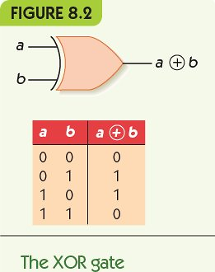
Encryption (DES) Data Encryption Standard (2 of 3)
Data Encryption Standard
DES manipulations
Split string
Duplicating some bits
Omit some bits
Permute bit order
Combine bit strings with XOR (exclusive OR)
Permutation
异或：两个都一样output false
不一样 output true
Symmetric encryption algorithm
Notes:
DES操作
分割字串
复制一些位
省略一些位
置换位顺序
将位串与XOR（异或）结合

Slide 29
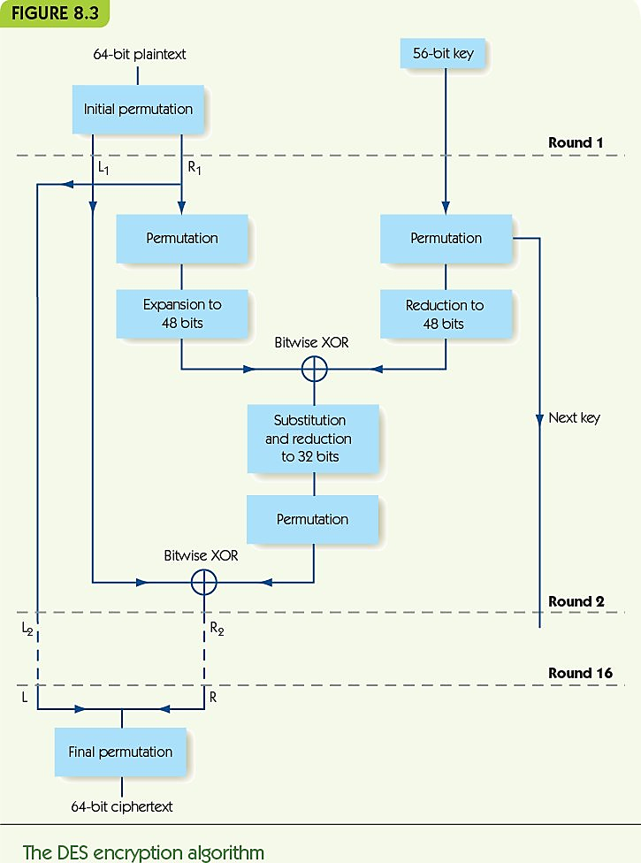
Encryption (DES) Data Encryption Standard (3 of 3)
Permutation：不改变数字，但重新排列数学顺序
Eg.
12345变成
14532
Permutation is a part of encryption standard

Slide 30
Encryption Public-Key Systems (1 of 4)
Belong to asymmetric
RSA key creation
Pick 2 large prime numbers: p and q
Compute n = p× q, and m = (p - 1)× (q - 1)
Choose large number e at random so that e and m are relatively prime (no common factors except 1)
Find unique value d, between 0 and m, such that
(e × d) modulo m = 1
Public key = (n, e); Private key = d
We start use RSA to communicate. We just use that to share some random number. Then we will use them for symmetric
Notes:
RSA密钥创建
选择2个大质数：p和q
计算n = p×q，m =（p-1）×（q-1）
随机选择大数e，以便e和m相对质数（除1外没有其他公因数）
找到介于0和m之间的唯一值d，这样
（e×d）模m = 1
公钥=（n，e）; 私钥= d

Slide 31
Encryption Public-Key Systems (2 of 4)
RSA key creation, example
p = 7, q = 13
n = 7 × 13 = 91, and m = 6 × 12 = 72
Let e = 77 (72 = 2 * 2 * 2 * 3 * 3, 77 = 7 * 11)
d = 29
Public key = (91, 25); Private key = 29

Slide 32
Encryption Public-Key Systems (3 of 4)
RSA encryption
Given public key (n, e)
Convert message to integer P
Calculate C = P^{e} modulo n
RSA decryption
Given private key d
Calculate C^{d} modulo n
Notes:
RSA加密
给定公钥（n，e）
将消息转换为整数P
计算C = Pe模n
RSA解密
给定私钥d
计算Cd模n

Slide 33
Encryption Public-Key Systems (4 of 4)
RSA encryption, example
Given public key (91, 25)
Convert message to integer P = 37
Calculate C = 37²⁵ modulo 91 = 46
RSA decryption
Given private key 29
Calculate 46²⁹ modulo 91 = 37

Slide 34
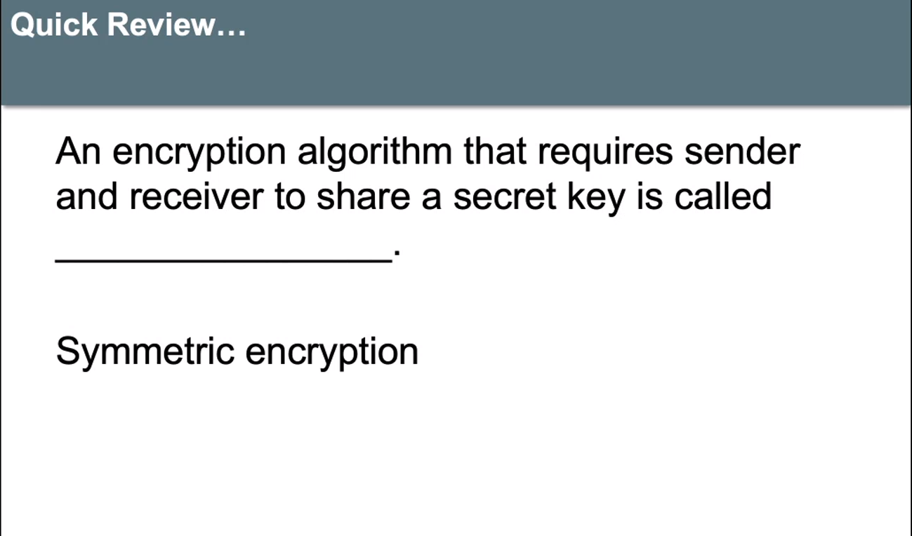

Slide 35
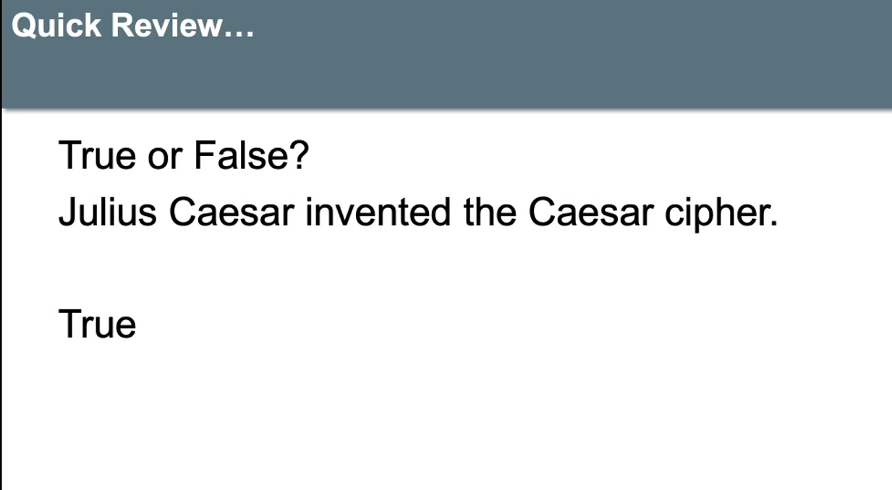

Slide 36
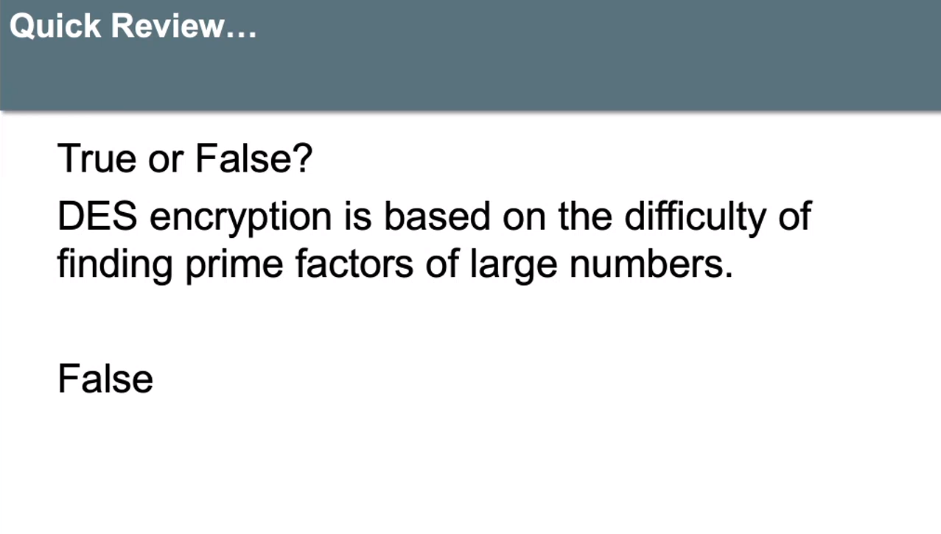

Slide 37
Web Transmission Security (1 of 2)
Ecommerce requires secure transmission of names, passwords, and credit card numbers
Web protocols: SSL (Secure Sockets Layer) and TLS (Transport Layer Security)
  Client-server applications
  Server provides certificate of authentication and server’s public key
  Client sends its DES key, encrypted using RSA
  Data is sent encrypted by the (now shared) DES key
eg.hppts
客户端发送使用RSA加密的DES密钥
通过（现在共享的）DES密钥加密发送数据
Notes:
电子商务需要安全地传输名称，密码和信用卡号
Web协议：SSL（安全套接字层）和TLS（传输层安全性）
客户端服务器应用程序
服务器提供身份验证证书和服务器的公钥
客户端发送使用RSA加密的DES密钥
通过（现在共享的）DES密钥加密发送数据

Slide 38
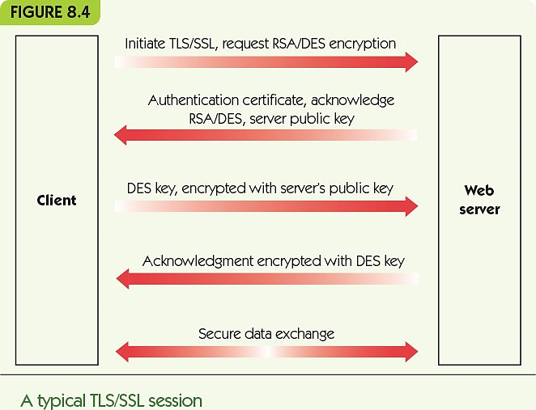
Web Transmission Security (2 of 2)

Slide 39
Embedded Computing
Embedded computers: special-purpose, limited computers in other systems
Examples: automobiles, smart appliances, remote controls, and patient monitoring systems
New trend: connect embedded computers to a network
  Transmit data, receive updates
Targeting embedded systems could cause chaos
  Change thermostats, disrupt patient care, or disable aircraft or automobiles
Notes:
嵌入式计算机：其他系统中的专用受限计算机
示例：汽车，智能电器，遥控器和患者监护系统
新趋势：将嵌入式计算机连接到网络
传输数据，接收更新
针对嵌入式系统可能会造成混乱
更改恒温器，中断患者护理或禁用飞机或汽车

Slide 40
Summary (1 of 2)
Internet and web are meant to promote information exchange, so information security is hard.
Online attacks include viruses, worms, Trojan horses, DoS attacks, and phishing, among others.
Data security involves encrypting sensitive data before transmitting or storing in unsecured location.
Symmetric encryption requires a shared key.
Asymmetric encryption uses public and private keys.
Notes:
Internet和Web旨在促进信息交换，因此信息安全很难。
在线攻击包括病毒，蠕虫，特洛伊木马，DoS攻击和网络钓鱼等。
数据安全性涉及在不安全的位置传输或存储之前对敏感数据进行加密。
对称加密需要共享密钥。
非对称加密使用公钥和私钥。

Slide 41
Summary (2 of 2)
Caesar cipher is a simple symmetric encryption; substitution ciphers are similar.
Block ciphers combine blocks of plaintext symbols into blocks of ciphertext.
DES and AES are strong symmetric encryption algorithms.
RSA is the most common asymmetric algorithm.
Secure web transmission requires protocols: SSL/TLS.
Embedded systems are the next problem to solve.
Notes:
凯撒密码是一种简单的对称加密。 替代密码相似。
分组密码将明文符号的分组合并为密文的块。
DES和AES是强大的对称加密算法。
RSA是最常见的非对称算法。
安全的Web传输需要以下协议：SSL / TLS。
嵌入式系统是下一个要解决的问题。

